Slide 1
Embark on a Journey: Threat Modeling with MITRE ATT&CK Framework
By: Brad Voris

Slide 2

“If you know the enemy and know yourself, you need not fear the result of a hundred battles.” – Sun Tzu
Notes:
This perfectly correlates to security.

Slide 3

Brad Voris, (a whole bunch of acronyms)
Lead InfoSec Architect @ Walmart Global Tech
25 years of experience IT/IS/CS
Undergrad in Cybersecurity @ Wilmington University
Certifications: CISSP, CISM, CCSP, CCSK, Network+, MTA, MCP, etc.
Co-Author 2 books: Intrusion Detection Guide and Essentials of Cybersecurity for Peerlyst
Cloud Security Alliance Zero Trust Training Contributor
NOT AN EXPERT

Slide 4

MITRE ATT&CK: Lets make it simple
Understand Threat Modeling
Understand the Components of ATT&CK
Select a Campaign, Industry, Threat Actor, etc.
Create Your Model
ROCK IT!

Slide 5
Threat modeling with ATT&CK
A process for improving security by identifying vulnerabilities and threats based on known attack vectors of threat actors
https://attack.mitre.org/
https://mitre-attack.github.io/attack-navigator/
https://attack.mitre.org/campaigns/
https://attack.mitre.org/matrices/enterprise/
Additional Training
https://attack.mitre.org/resources/learn-more-about-attack/training/
Links you will need

Slide 6
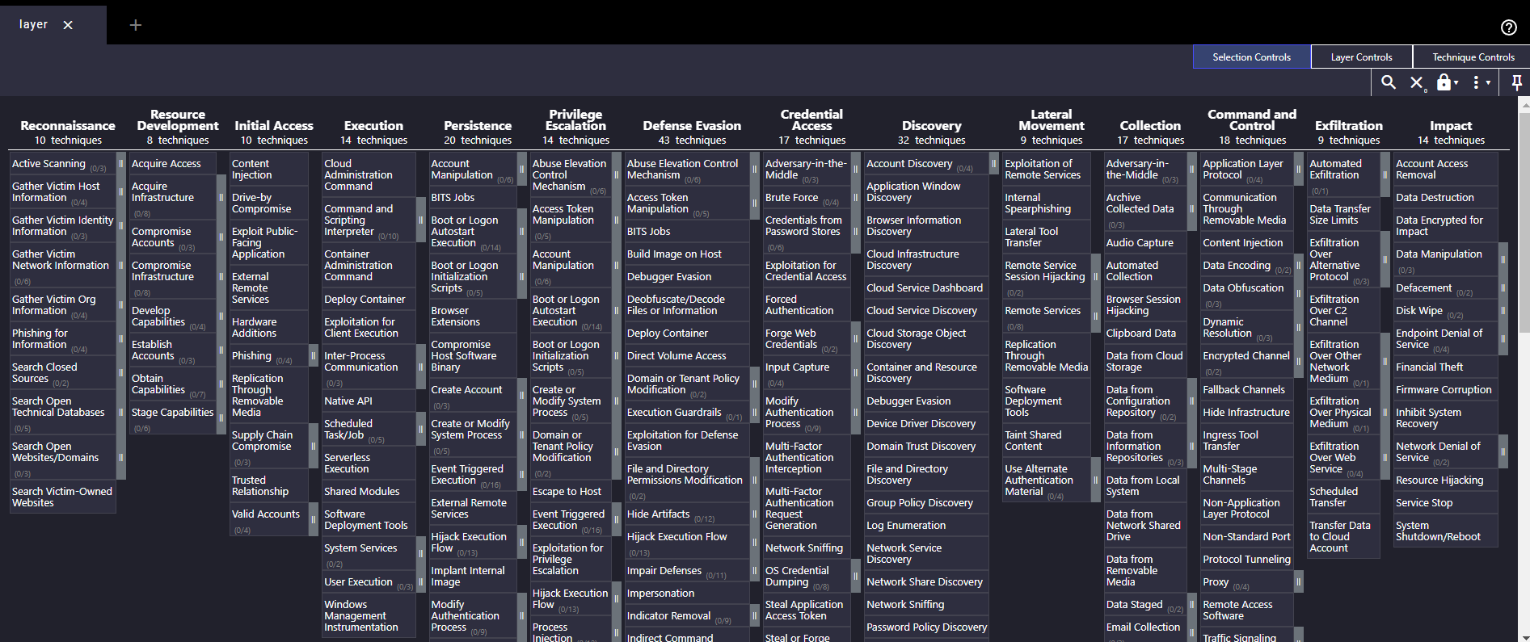
Could This Be Anymore Overwhelming?

Slide 7
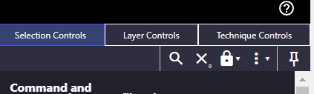
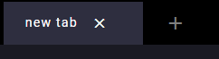
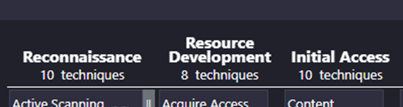
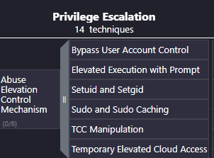
Framework Components
New Tab
For uh new tabs…
Matrix Control Plane
Makes it “PRETTY”
well maybe not pretty…
TTPs: Threats, Tactics, Procedures
Attack
Tactics
The “WHY”
Attack Techniques
The
“HOWS”

Slide 8
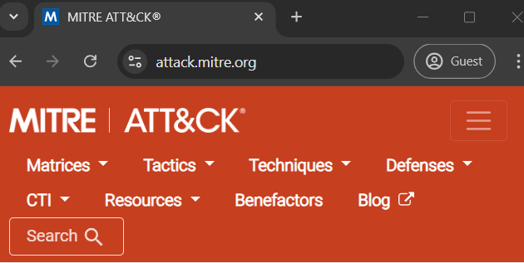
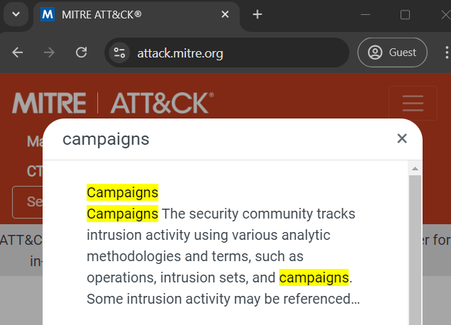
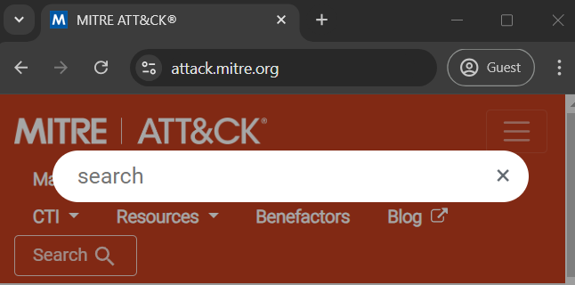
Select Your Model Context
We will select a couple campaigns that focus on petroleum industry because this is HOUSTON. Here’s how:

Slide 9
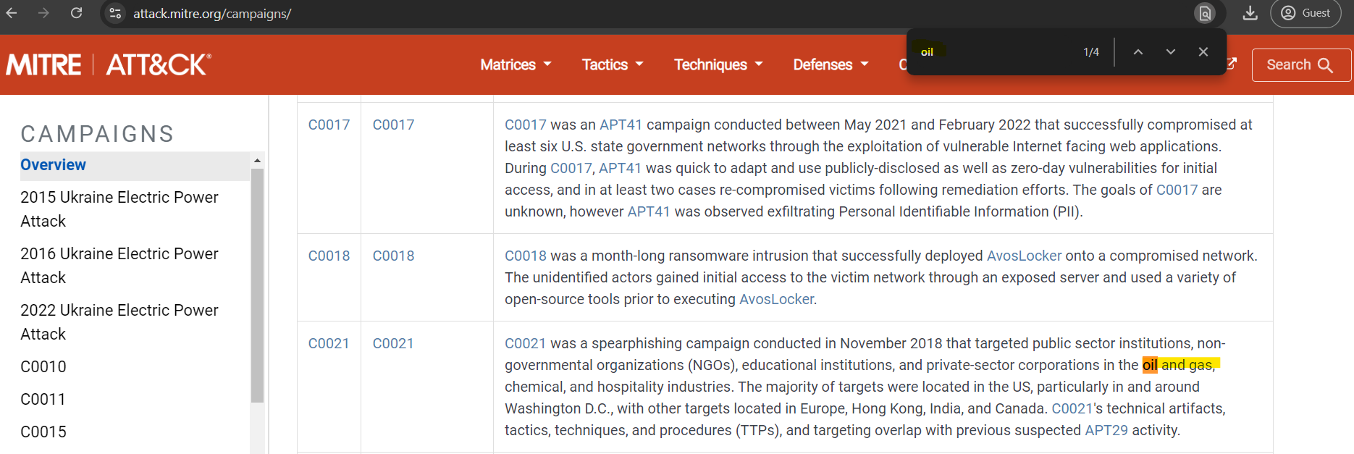
Quick Search (Yes I know I can use “Search”) Ctrl-f is so much better…

Slide 10
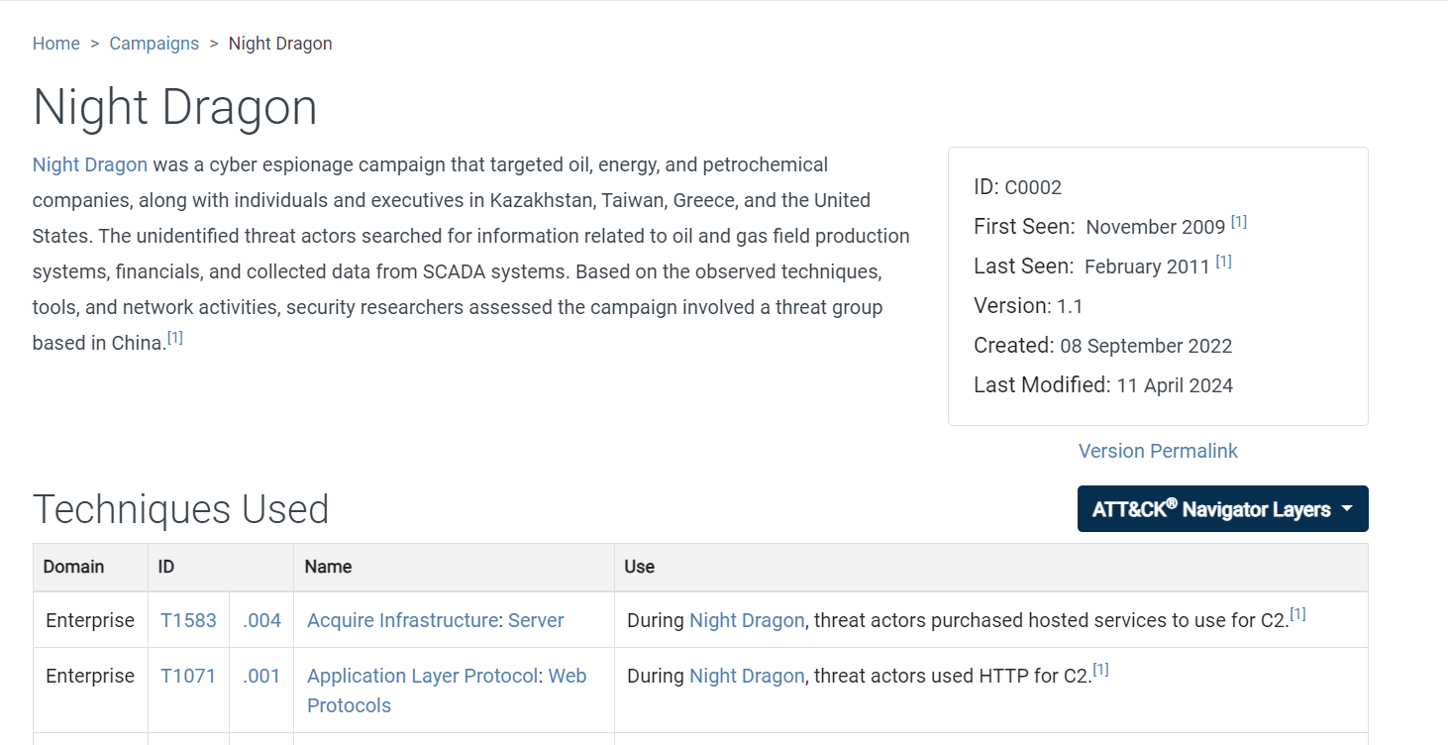
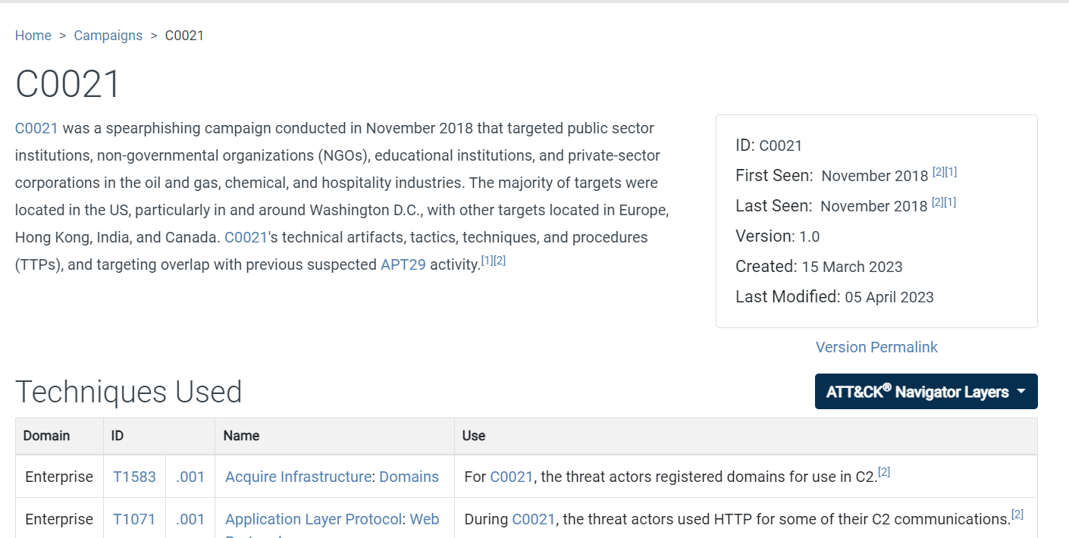
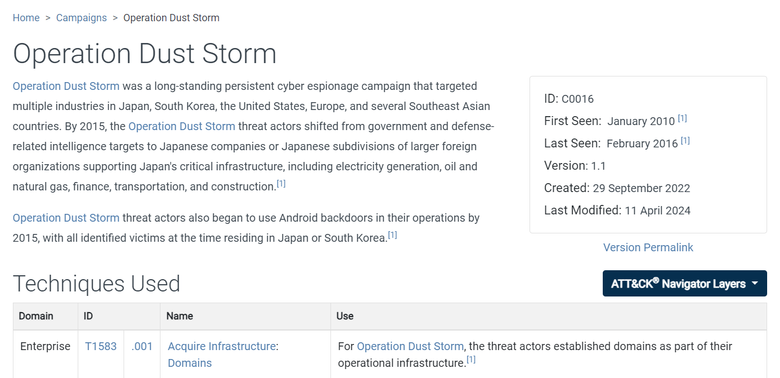
Campaigns/Threat Actors Selected

Slide 11
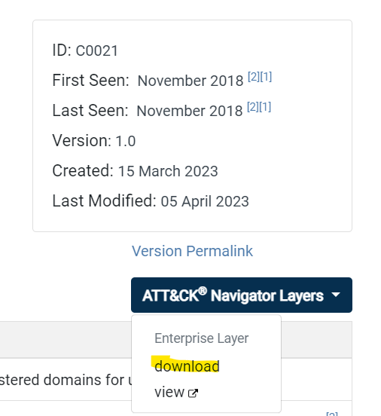
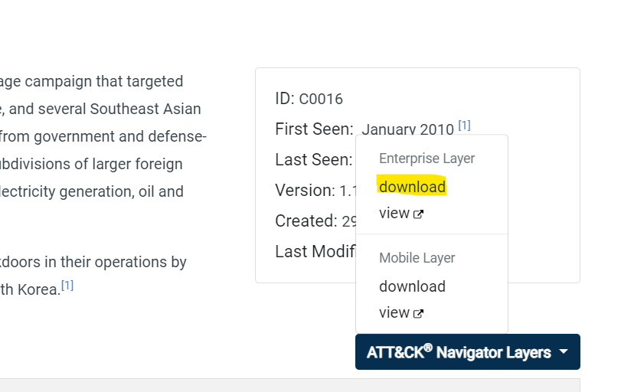
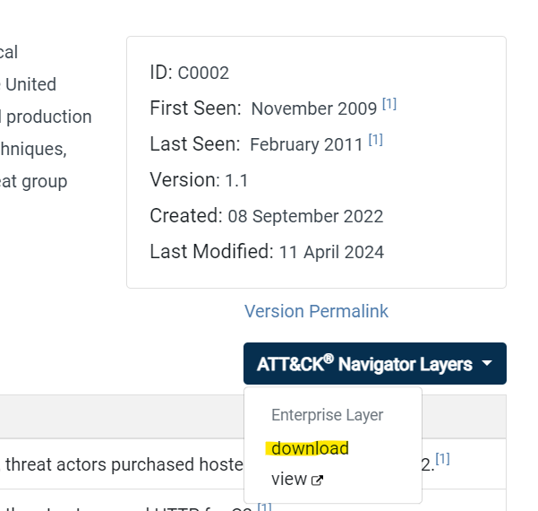
Download the Campaign Data for Each

Slide 12
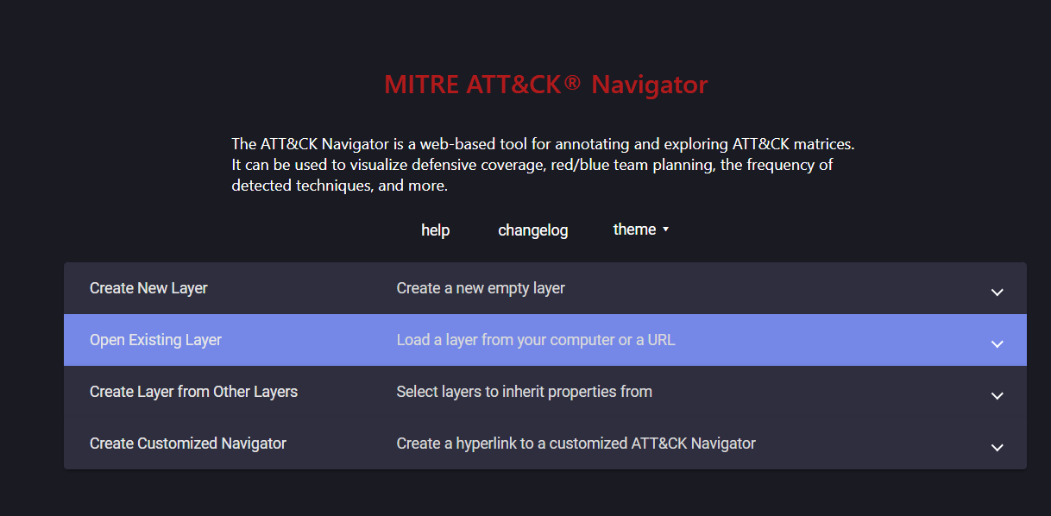
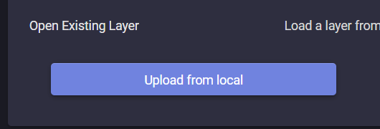
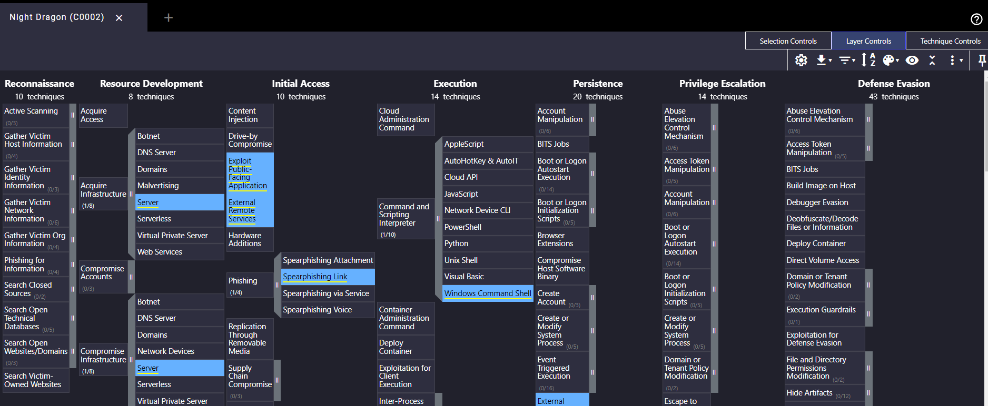
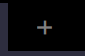
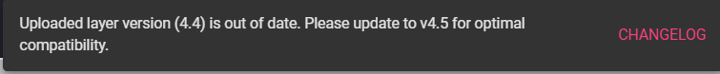
← Hey MITRE: CHANGELOG Error with no context…
Import the Campaign Data for Each

Slide 13
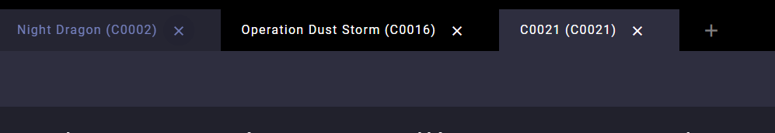
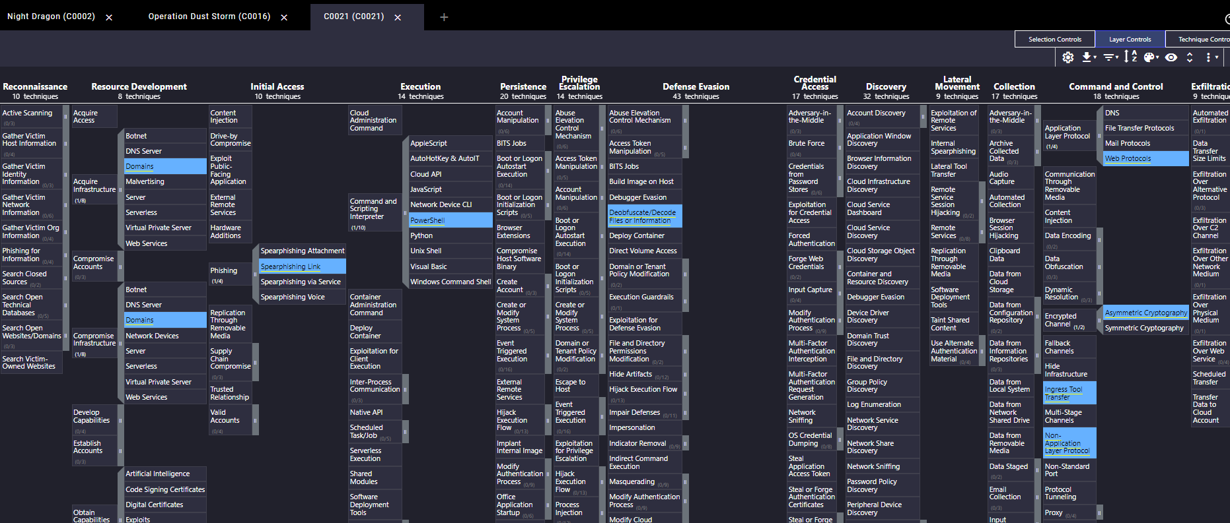
Once Campaign Data is Imported

Slide 14
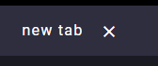
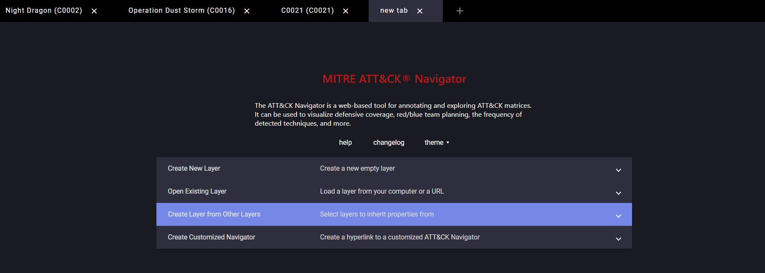
Create a New Layer From Other Layers

Slide 15
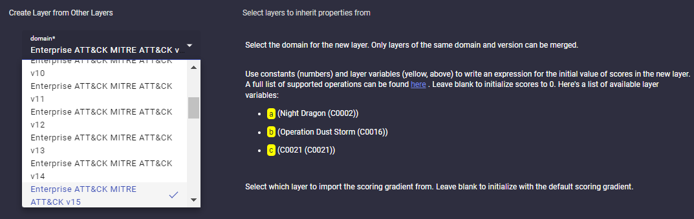
Select Enterprise ATT&CK MITRE ATT&CK v15

Slide 16
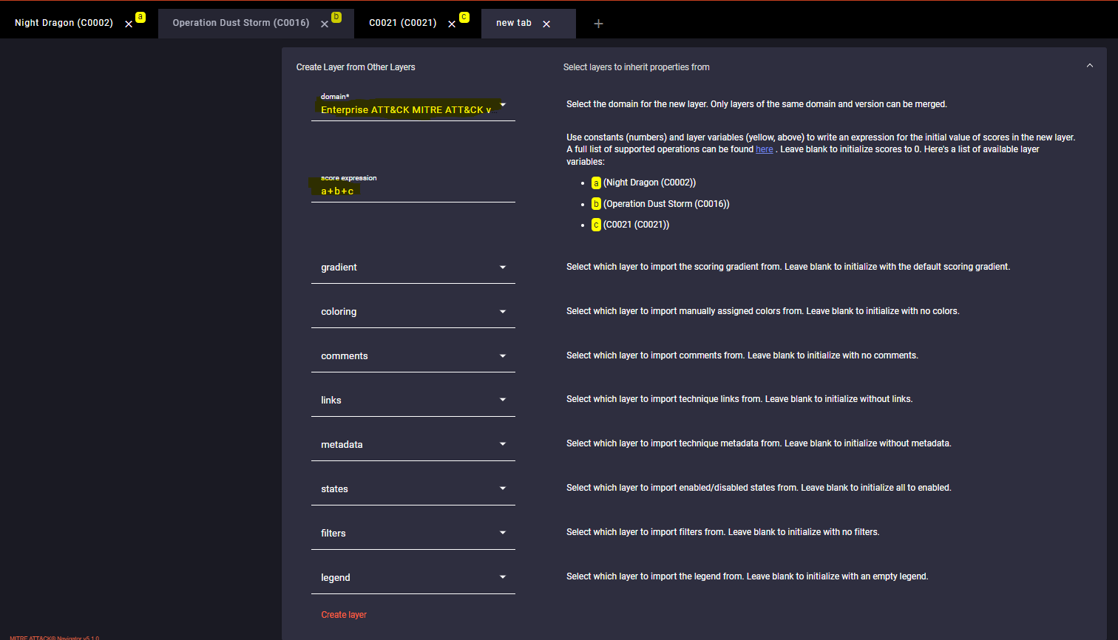
A+B+C no this isn’t Pythagorean or ABC conjecture… I promise….

Slide 17
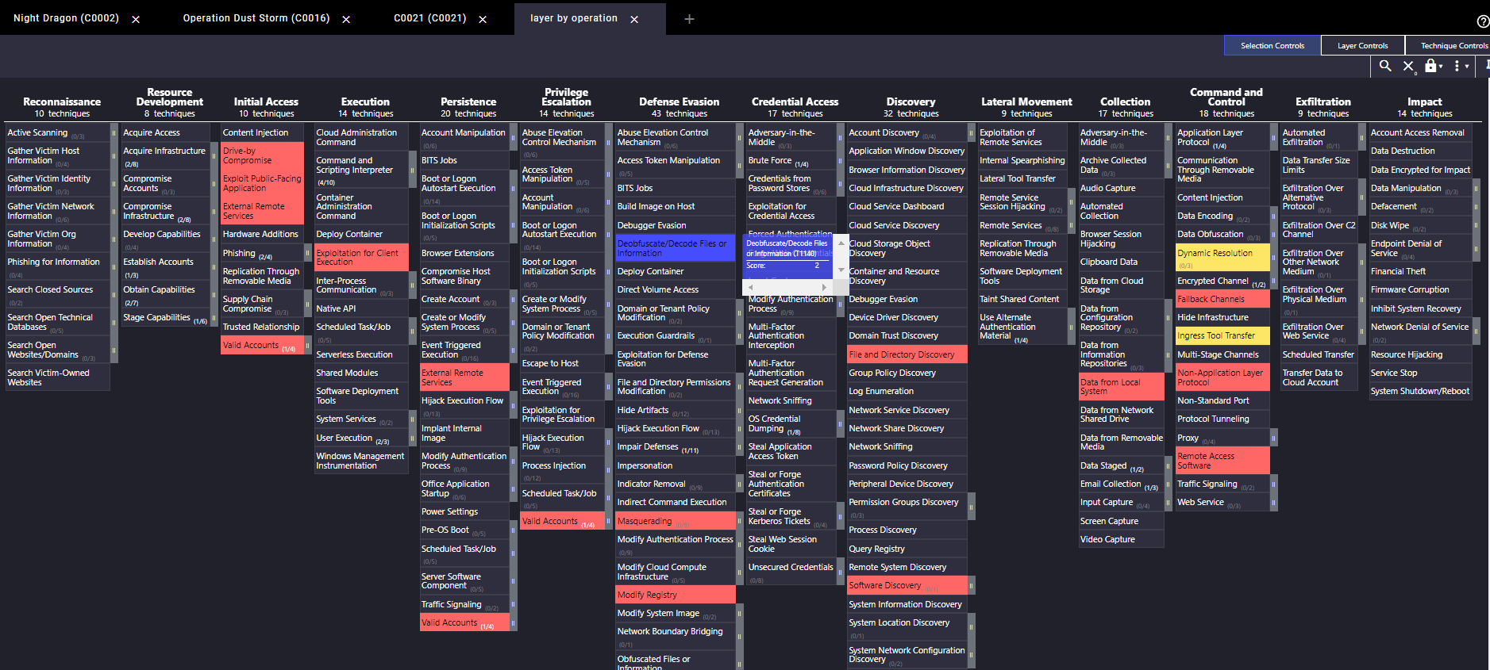
Comprehensive threat model of scenarios based on known campaigns of threat actors targeting the Petroleum Industries… VERY EASY…to see, not to say.

Slide 18
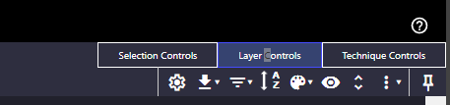
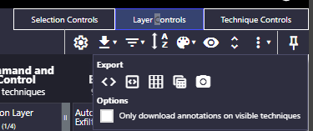
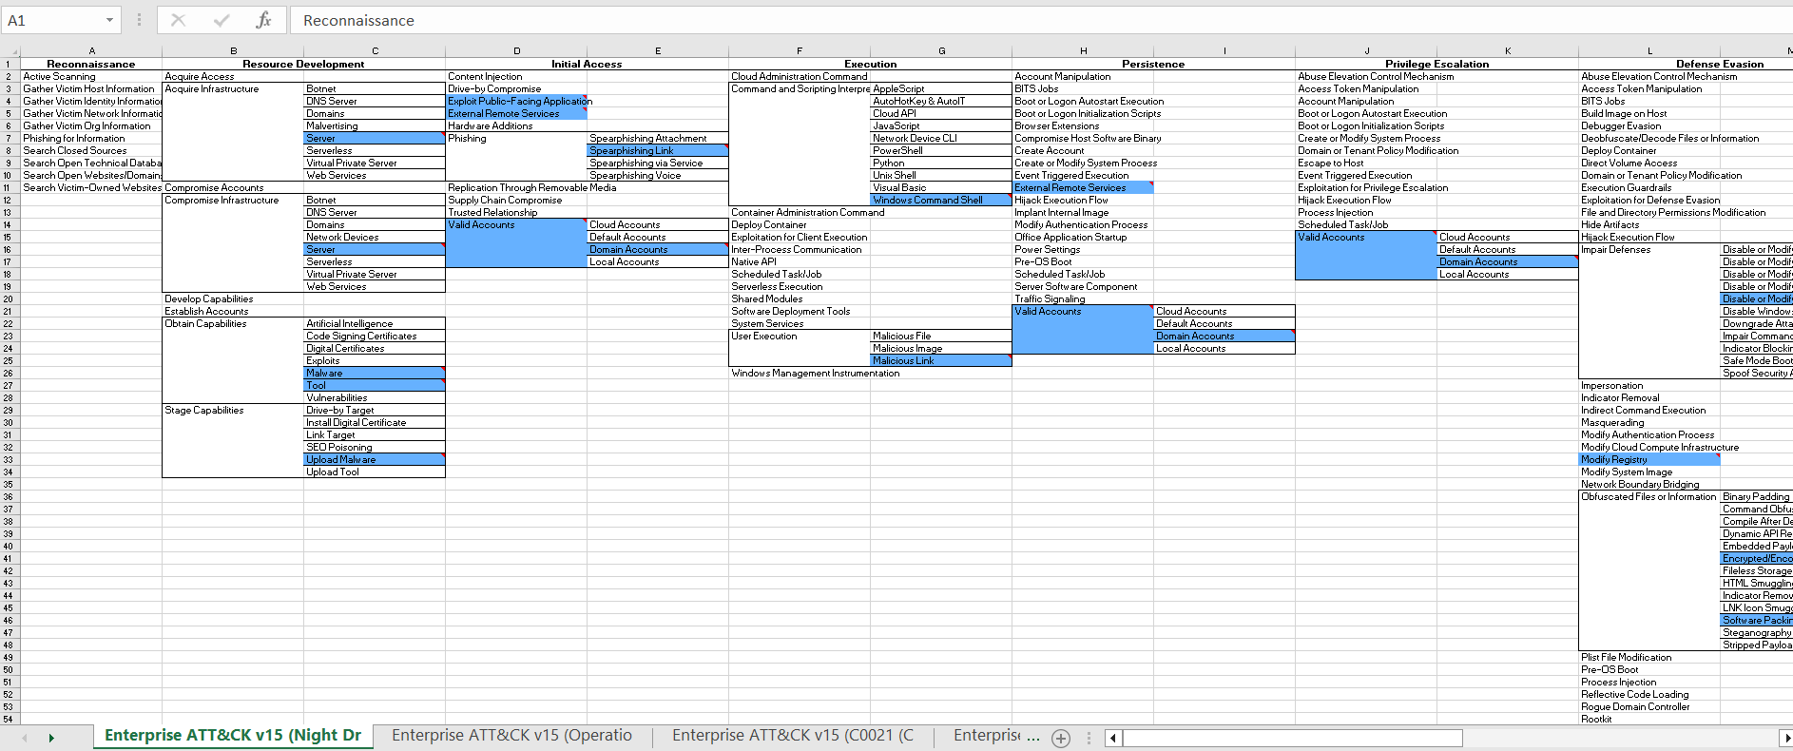
But Brad You Charismatic Gentleman, Do I Have to Do This Every Time? No…
This Can Be Exported to the Following Formats:
JSON
Excel
SVG

Slide 19
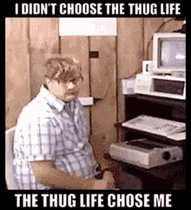
Ok I Have The Data Now What?
This is how you Embark on a Journey….
Build scenarios to test and validate for your assets security posture
Determine gaps in security controls
Integrate this function into design of security controls
Train your team
Impress your friends!

Slide 20
Questions? Come up front and see me!

Slide 21
Thanks for connecting with me!
https://linktr.ee/bradvoris
https://www.linkedin.com/in/brad-voris/
https://github.com/bvoris
https://x.com/HMInfoSecViking

